Slide 1
P1009 – BANK ANALYTICS
Group 5
Saakshi Kartik Naik
Rajat Kumar
Vivek Hosmath
Asha Poojary
Abdul Rajak A Patel
Chandana G
Kirti Ramesh Waghmare

Slide 2
Introduction What is Bank Analytics?
The use of data analysis to improve banking operations
Supports decision-making, risk management, and customer insights
Objectives:
Understand key metrics
Explore use cases
Discuss tools and trends

Slide 3
Introduction:
Bank Loan Analytics involves analyzing lending data to gain insights into loan performance, customer behavior, and overall financial health.
This analysis helps banks identify trends, manage risk, improve loan approval processes, and reduce default rates.
To understand the distribution of loans across different categories
To evaluate loan performance metrics such as total funded amount, collections, and defaults
To identify high-risk segments and improve decision-making
To derive actionable insights for better financial planning and risk management

Slide 4
Key Metrics & KPIs
Net Interest Margin
Loan Default Rate
Customer Lifetime Value
Why They Matter:
Drive strategic decisions
Monitor performance
Predict future trends

Slide 5
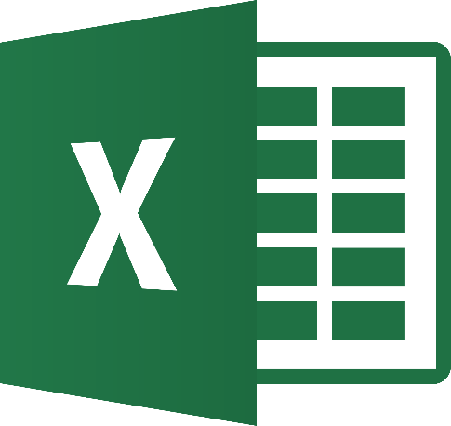



Scope of Bank Analytics
Bullet Points:
Customer demographics
Transaction history
Credit risk profiles
Tools Used:
Tableau
Power BI
SQL
Python

Slide 6
Use Cases: Real-World Applications
Fraud detection using anomaly detection
Credit scoring with predictive models
Customer segmentation for targeted marketing
Branch performance optimization

Slide 7
Data Visualization Examples
Bullet Points:
KPI cards for loan performance
Clustered column charts for revenue by region
Histograms for customer age distribution

Slide 8
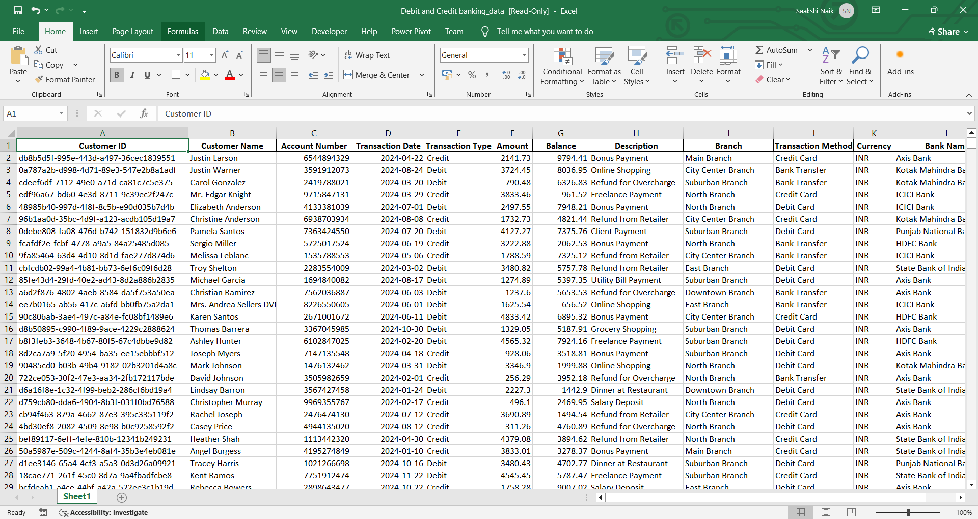
Data set:
Debit and Credit Banking data

Slide 9
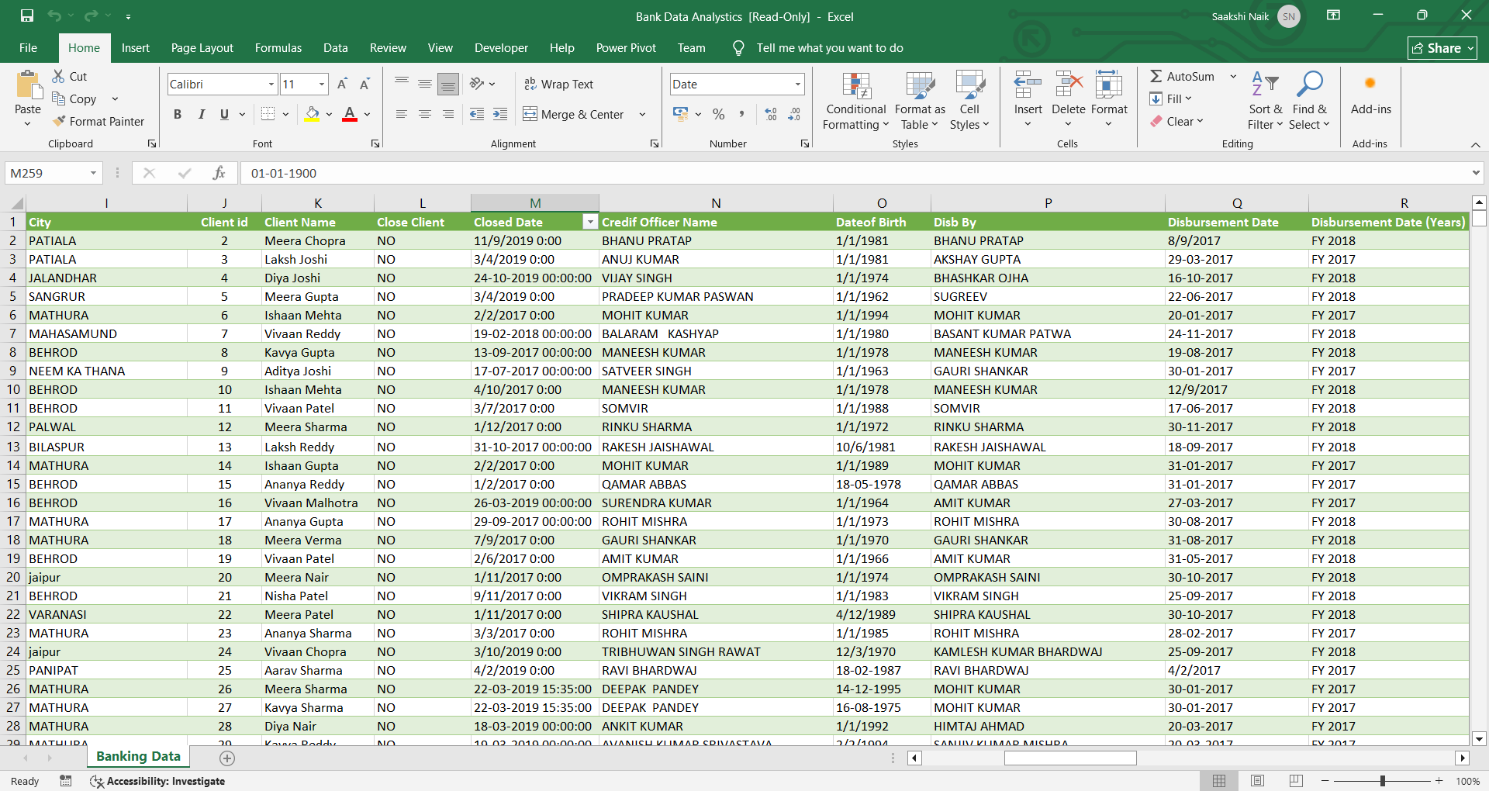
Data set:
Bank Loan analytics data set:

Slide 10
Data Cleaning Process
Steps Performed:
Identified and deleted duplicate records to maintain unique loan entries.
Converted columns to appropriate data types- Date Format
Converted Text into Aligned text.
Result: A clean, consistent dataset ready for accurate analysis and visualization in Power BI or Excel.

Slide 11
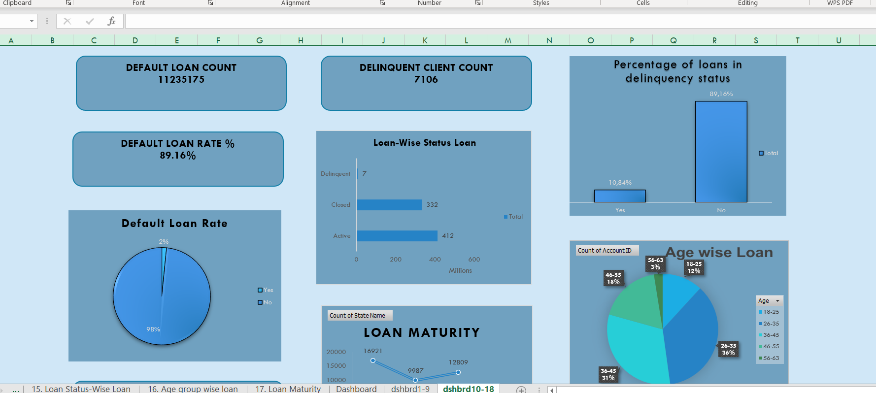
Excel- Bank loan dashboard

Slide 12
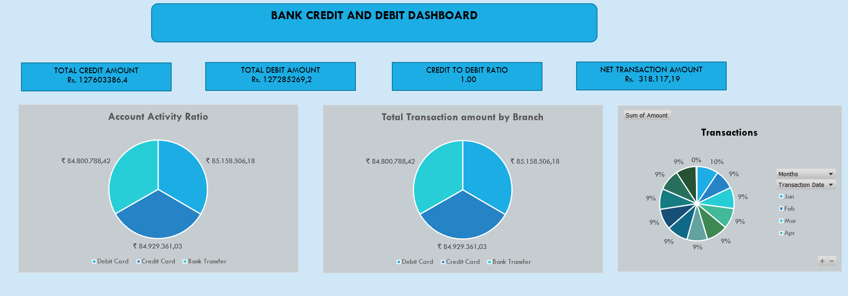
Excel- Debit and credit dasboard

Slide 13
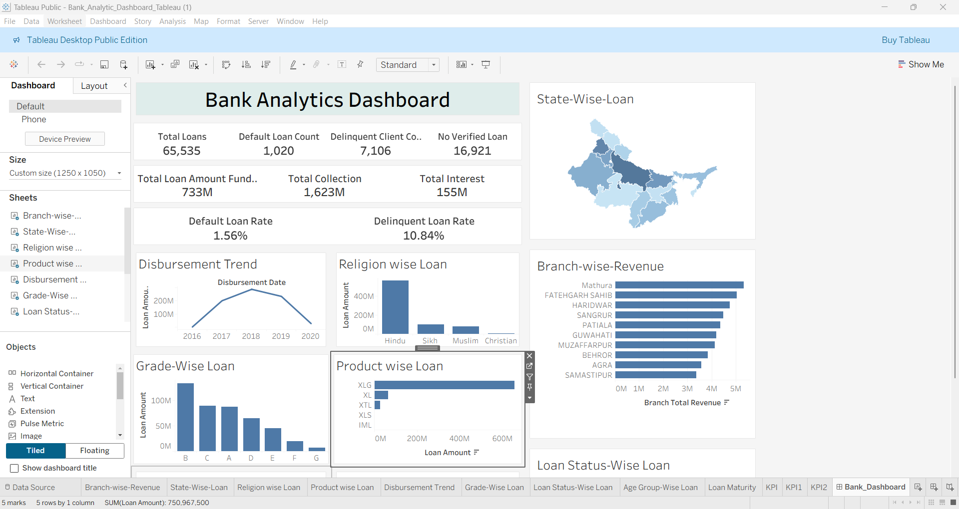
Tableau - Bank loan analytics dashboard

Slide 14
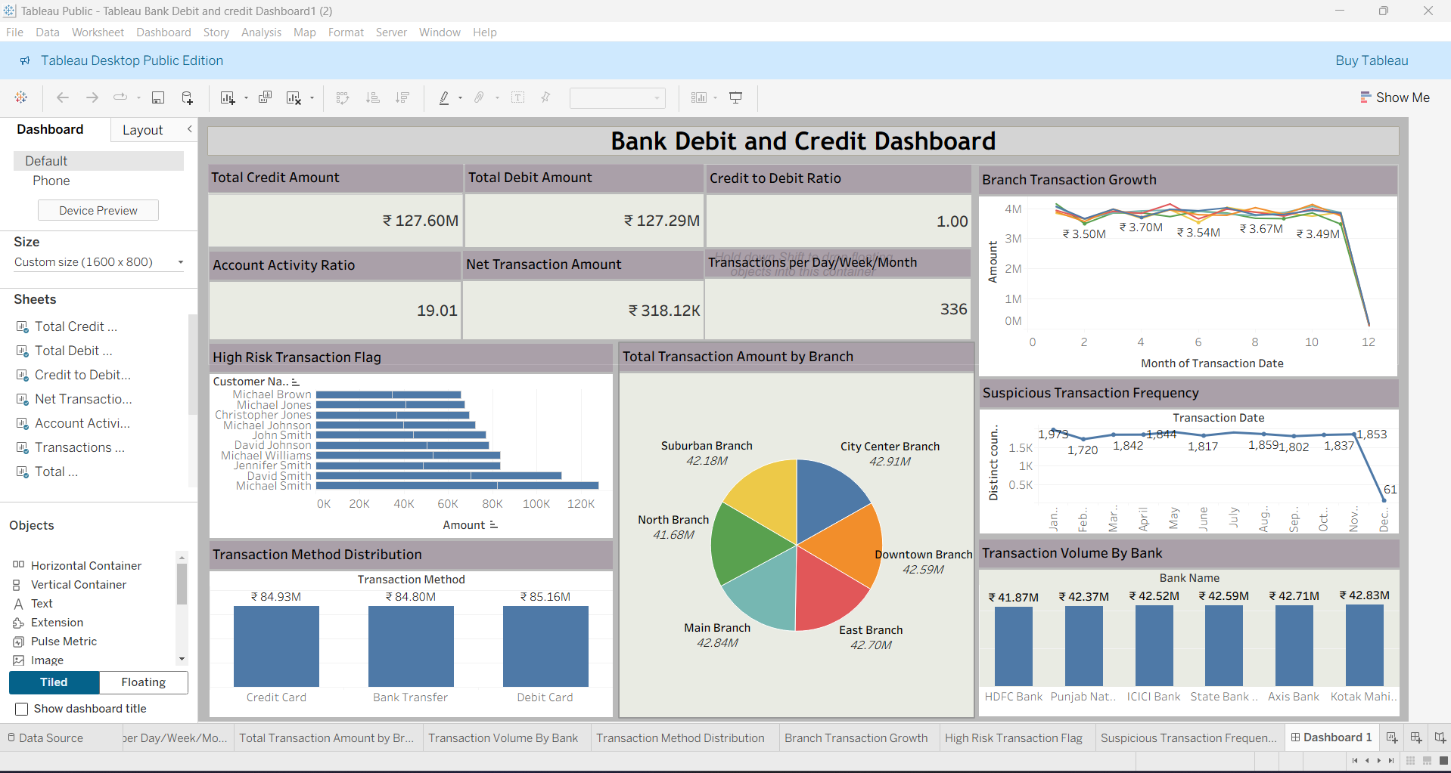
Tableau- Debit and Credit dashboard

Slide 15
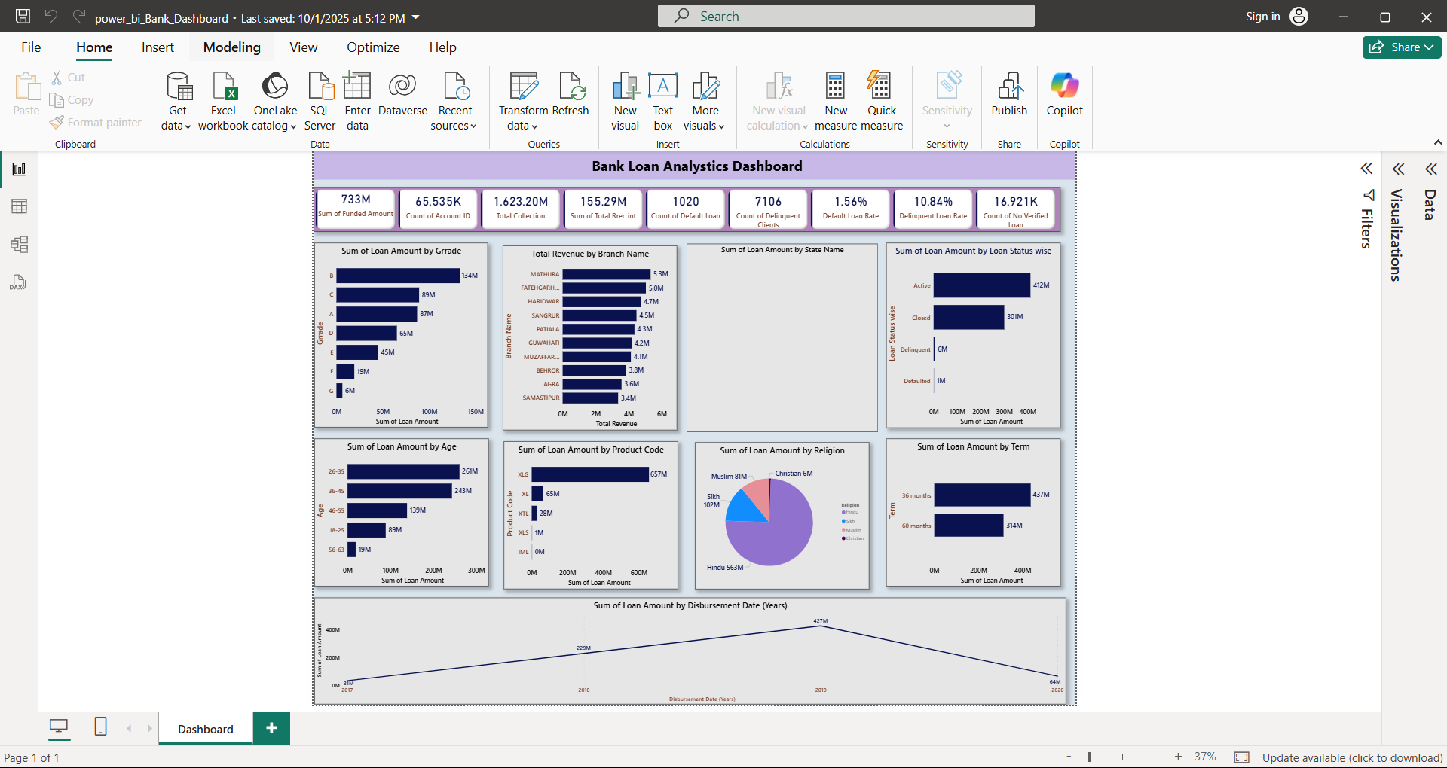
Power Bi - Bank loan Analytics dashboard

Slide 16
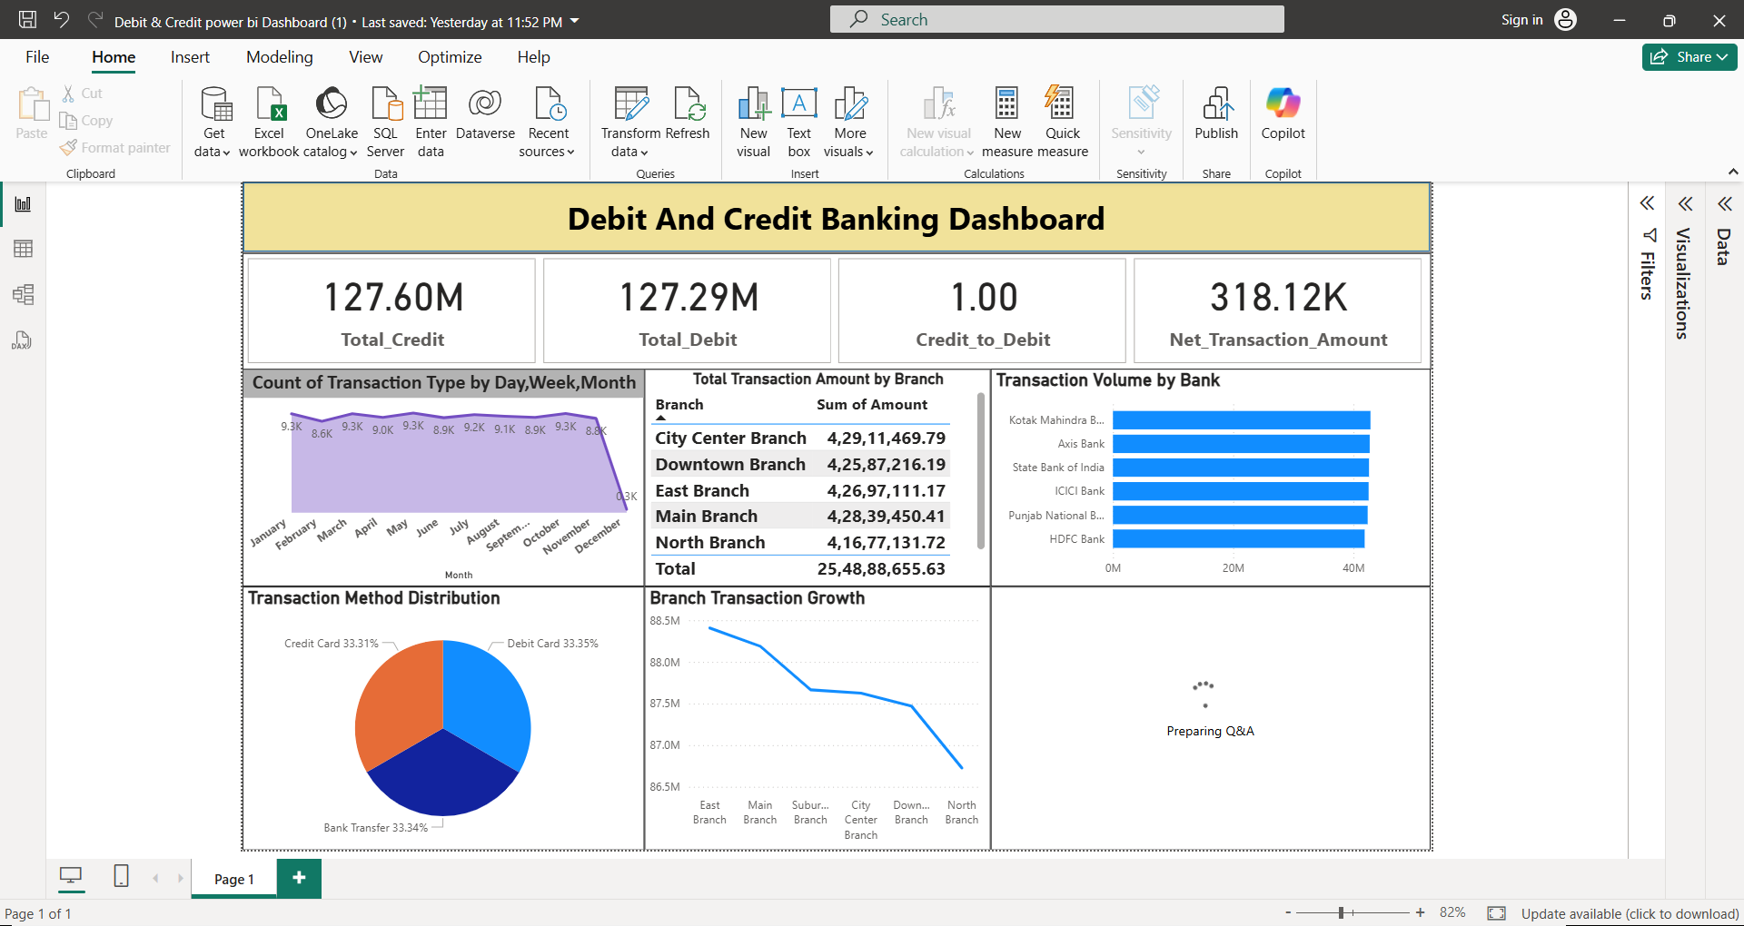
Power Bi- Debit and credit Dashboard

Slide 17
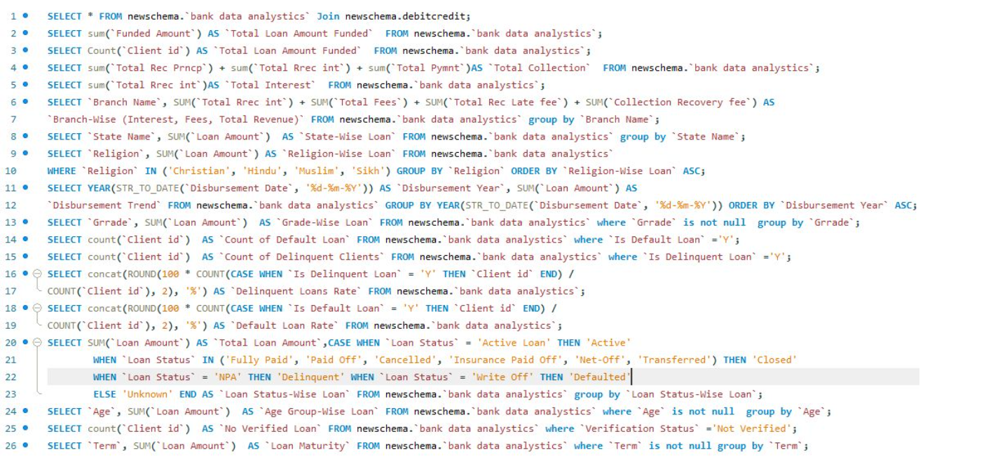
SQL QUERIES

Slide 18
Challenges in Bank Analytics
Data privacy and compliance (e.g., GDPR)
Integration with legacy systems
Real-time analytics constraints
Data quality and completeness

Slide 19
What’s Next in Bank Analytics?
AI & ML for predictive banking
Real-time personalization
Blockchain for secure transactions
Chatbots for customer service

Slide 20
Conclusion
Key Takeaways:
Bank analytics transforms decision-making
Visualization tools enhance clarity
Future is data-driven and customer-centric

